Slide 1

STRING MATCHING ALGORITHMS
Presented By:-
Md. FoysaL Mahmud
University of Barisal

Slide 2
Index
What is String?
What is String Matching?
Definition of Algorithm.
String Matching Algorithms.
String Matching Algorithms with Example.

Slide 3
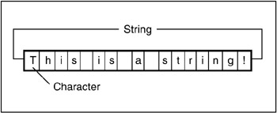
What is String?
In computer programming, a string is traditionally a sequence of characters, either as constant or as some kind of variable.
E.g. Foysal or 14CSE028

Slide 4
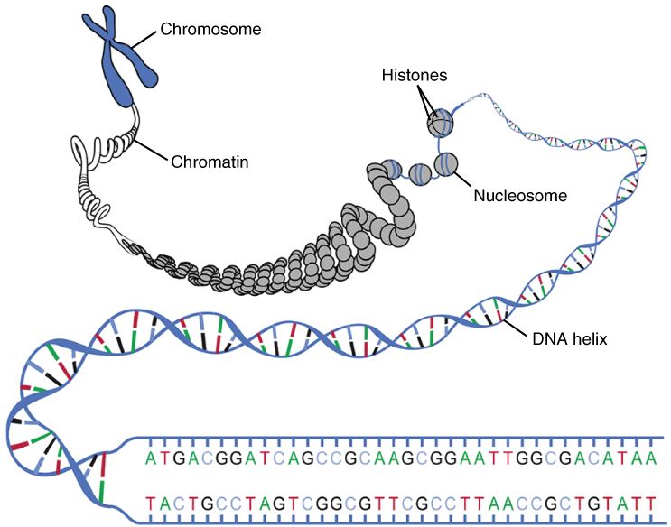
What is String?
String may be applied in Bioinformatics to describe DNA strand composed of nitrogenous bases

Slide 5
What is String matching?
In computer science, string searching algorithms, sometimes called string matching algorithms, that try to find a place where one or several string (also called pattern) are found within a larger string or text.
Example: We have a string “Abcdefgh” and the pattern to be searched is “Def”. Now finding “def” in the string “Abcdefgh” is string matching.

Slide 6
EXAMPLE
STRING MATCHING PROBLEM
A | B | C | A | B | A | A | C | A | B
TEXT
SHIFT=3
A | B | A | A
PATTERN

Slide 7
STRING MATCHING ALGORITHMS
There are many types of String Matching
Algorithms like:-
1) The Naive string-matching algorithm
2) The Rabin-Krap algorithm
3) String matching with finite automata
4) The Knuth-Morris-Pratt algorithm

Slide 8
Naïve String Matching Algorithm

Slide 9
EXAMPLE
SUPPOSE,
T=1011101110
P=111
FIND ALL VALID SHIFT……
1 | 0 | 1 | 1 | 1 | 0 | 1 | 1 | 1 | 0
S=0
P=Pattern
1 | 1 | 1

Slide 10
1 | 0 | 1 | 1 | 1 | 0 | 1 | 1 | 1 | 0
S=1
1 | 1 | 1

Slide 11
1 | 0 | 1 | 1 | 1 | 0 | 1 | 1 | 1 | 0
S=2
1 | 1 | 1
So, S=2 is a valid shift…

Slide 12
1 | 0 | 1 | 1 | 1 | 0 | 1 | 1 | 1 | 0
S=3
1 | 1 | 1

Slide 13
1 | 0 | 1 | 1 | 1 | 0 | 1 | 1 | 1 | 0
S=4
1 | 1 | 1

Slide 14
1 | 0 | 1 | 1 | 1 | 0 | 1 | 1 | 1 | 0
S=5
1 | 1 | 1

Slide 15
1 | 0 | 1 | 1 | 1 | 0 | 1 | 1 | 1 | 0
S=6
1 | 1 | 1
So, S=6 is a valid shift…

Slide 16
1 | 0 | 1 | 1 | 1 | 0 | 1 | 1 | 1 | 0
S=7
1 | 1 | 1

Slide 17
Naïve String Matching Algorithm
void search_pattern(string ptr,string txt){
int p=ptr.size();
int t=txt.size();
for(int i=0;i<=t-p;i++) {
int j;
for(j=0;j<p;j++){
if(txt[i+j]!=ptr[j])
break; }
if(j==p)
“Pattern Found”;
}

Slide 18
THE RABIN-KARP ALGORITHM
Rabin and Karp proposed a string matching algorithm that performs well in practice and that also generalizes to other algorithms for related problems, such as two-dimentional pattern matching.
Its complexity O(mn)

Slide 19
Formula:
First select a prime number,like prime=101.
Then find the hash value of Pattern.
Here, Text=“abcdabc”
Pattern=“cda”
*hash value of pattern=
99 + (100*101) + (97*(101)^2)
= 999696
Now apply the following steps:
X=old hash – Value (old char)
X= x/prime .
New hash = x + (prime)^(p-1) * value(new char)

Slide 20
Text = abcdabc
abc = 97+98*101+99*(101)^2
= 1019894 != 999696
Text = abcdabc
bcd = old hash – Value (old char)
= 1019894 – 97
= 1019797 / 101
= 10097 + 100*(101)^2 =1030197 != 999696

Slide 21
Text = abcdabc
cda = 1030197 – 98 = 1030099 / 101
= 10199 + 97*(101)^2
= 999696 == 999696 (Pattern match)
Text = abcdabc
dab = 999696 – 99 = 999597/101
= 9897 + 98*(101)^2
= 1009595 != 999696
Text = abcdabc
abc = 1009595 – 100
= 1009495 / 101 = 9995 + 99*(101)^2
= 1019894 != 999696

Slide 22
So Pattern found in that text.
Text = ABCDABC
Pattern = CDA
Like the Naive Algorithm, Rabin-Karp algorithm also slides the pattern one by one. But unlike the Naive algorithm, Rabin Karp algorithm matches the hash value of the pattern with the hash value of current substring of text, and if the hash values match then the Pattern is found in the Text.

Slide 23
Coding :
int prime=101;
string pattern,text;
int p=pattern.size();
int t=text.size();
int val=text[0]-'0';
int pattern_value= (pattern[0]-'0')+((pattern[1]-'0')*prime)+
((pattern[2]-'0')*pow(prime,2));
int check;
for(int i=0;i<p;i++){
check=(text[0]-'0')+((text[1]-'0')*prime)+((text[2]-'0')*pow(prime,2));
}
if(check==pattern_value) “Pattern Found”

Slide 24
int check_temp=check;
for(int j=1;j<t;j++)
{
int i=j-1;
int temp,check2;
check2=check_temp;
temp=check2-(text[i]-'0');
temp=temp/prime;
check_temp=temp+((text[j+2]-'0')*pow(prime,2));
if(check_temp==pattern_value){
“Pattern Found at (j+1) index”;
break;
}
}

Slide 25
Knuth-Morris-Pratt Algorithm
Knuth-Morris-Pratt Algorithm has 2 stage:
1. Prefix Function.
2. String Matching.

Slide 26
Text = abxabcabcaby
Pattern = abcaby
Now Find Pattern Index:
j i
a b c a b y
Here j!=i , So index will be 0.
0 | 0

Slide 27
Now i is increase… i++;
j i
a b c a b y
Here j!=i , So index will be 0.
0 | 0 | 0

Slide 28
Now i is increase…. i++;
j i
a b c a b y
Now j==i then index = j+1
= 0+1 = 1
0 | 0 | 0 | 1

Slide 29
Now both i and j will be increase. i++,j++;
j i
a b c a b y
Now j==i then index = j+1
= 1+1 = 2
0 | 0 | 0 | 1 | 2

Slide 30
Now both i and j will be increase. i++,j++;
j i
a b c a b y
Now j!=i, So look previous index value.
And Check the index number while represent the value.
0 | 0 | 0 | 1 | 2

Slide 31
j i
a b c a b y
Now start checking from ‘a’.
0 | 0 | 0 | 1 | 2

Slide 32
j i
a b c a b y
Now j!=i , So index will be 0.
0 | 0 | 0 | 1 | 2 | 0

Slide 33
String Matching
Text = abxabcabcaby
Pattern = abcaby
a b x a b c a b c a b y
a b c a b y
0 | 0 | 0 | 1 | 2 | 0

Slide 34
Here c!=x , So it will go pattern index table previous character value.
b = 0;
So it will start matching from 0 index of the pattern.
a b x a b c a b c a b y
a b c a b y

Slide 35
a b x a b c a b c a b y
a b c a b y
Pattern index:0 1 2 3 4 5
Here y!=c , So it will go pattern index table previous character value.
b = 2;
So it will start matching from 2 index of the pattern.

Slide 36
a b x a b c a b c a b y
a b c a b y
Now Pattern is found in the Text….. ☺
That’s way KMP algorithm works.
Its complexity O(m+n)

Slide 37
THANK YOU…☺

